Slide 1

Automatic
Sun Tracking System
Group 5

Slide 2



Team members
Noor E Jannat Nafia
ID:
MD Shahriyar Al Mustakim Mitul
ID:
MD Shadman Razeen
ID: 21301079

Slide 3

Our Project
We tried to solve the efficiency issue for a solar panel being unused for most of the time.

Slide 4
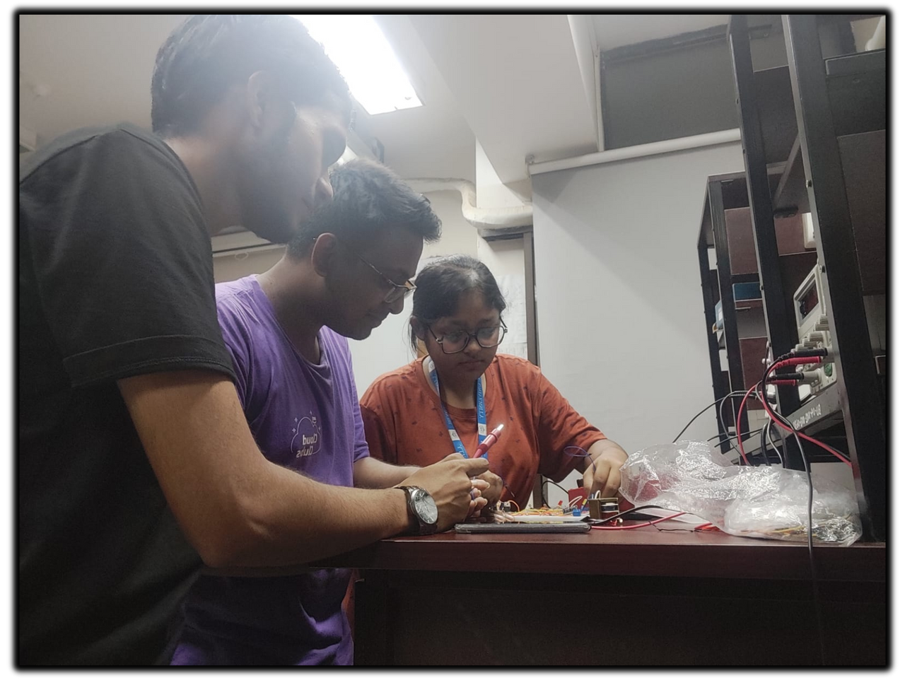
Our Project (hands on)
Here we created a project where we light up LEDs depending on the light.
Idea:
We used some LDRs to detect the light emitted by them.
Then we compared the voltage and illuminated the LEDs
Let's know how we built this awesome project

Slide 5
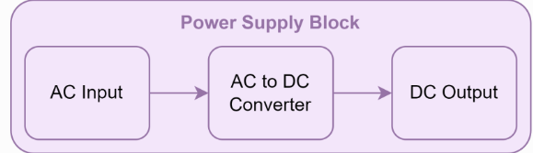
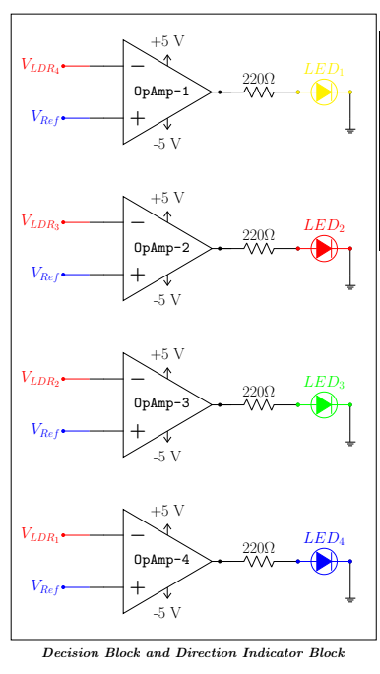
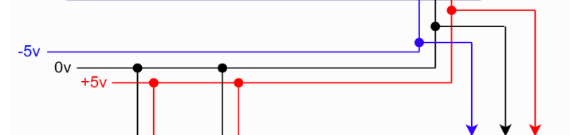
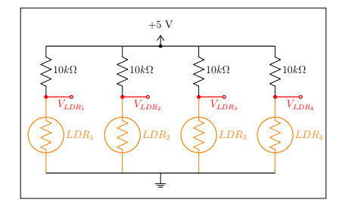
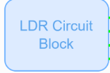
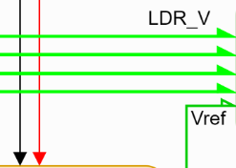
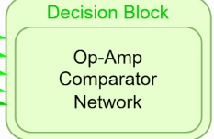
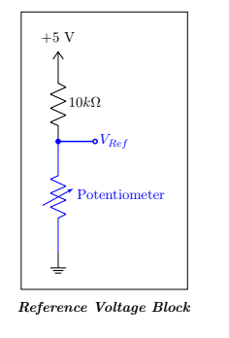
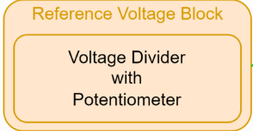

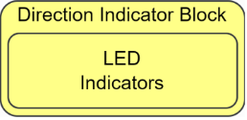
Our Project in blocks
Step-down Transformer: for high voltage AC to low voltage AC conversion
Full-wave Rectifier: for AC to DC conversion
Voltage Regulator(7805 IC): for stable DC output

Slide 6
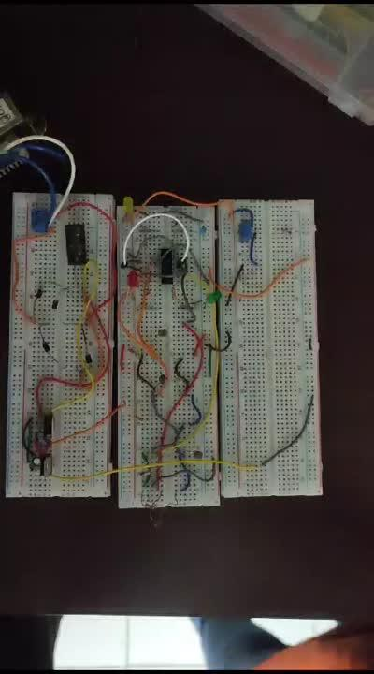


A Demo of Our Project Responding to Light

Slide 7
Thank You!

